Slide 1
Sparso Context-driven Optimizations of Sparse Linear Algebra
Hongbo Rong, Jongsoo Park, Lingxiang Xiang,
Todd Anderson, Mikhail Smelyanskiy
Parallel Computing Lab (PCL)
Intel, Santa Clara
PACT 2016
Notes:
Hello everyone. Introduce the topic and each author.

Slide 2
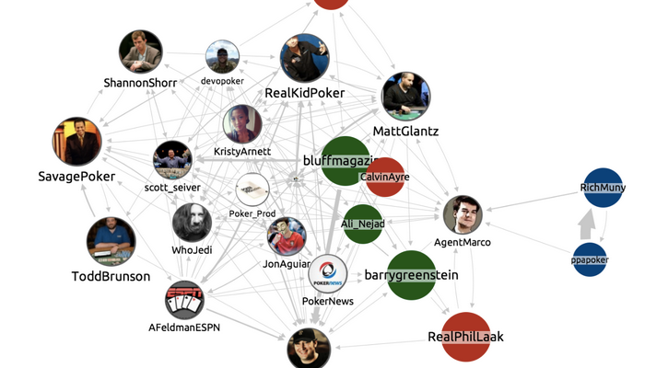
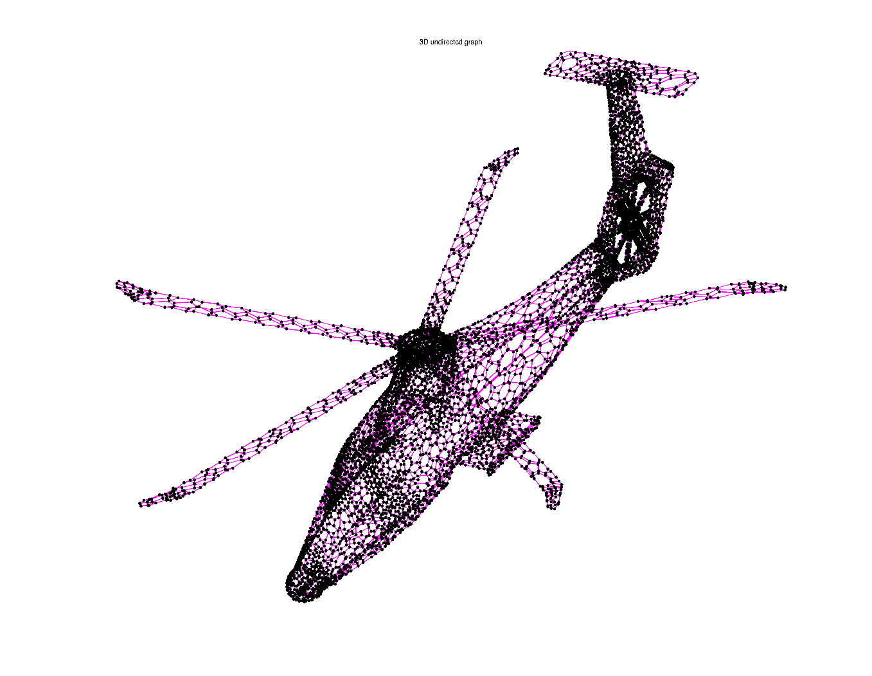
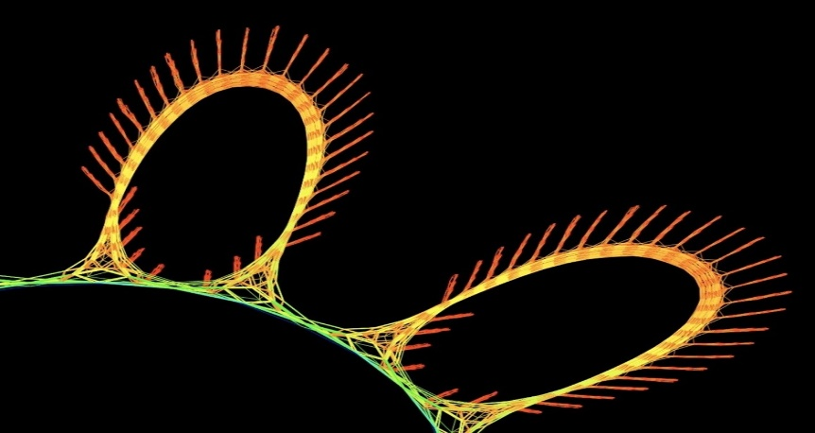
Sparse connection is everywhere
Social graph analysis
Physical simulation
Sources of the graphs:
1. Davis and Hu. http://www.cise.ufl.edu/research/sparse/matrices/
2. https://www.linkedin.com
Financial analysis
Notes:
Why is the sparse matrix important? Because it represents sparse connection. This is a connect world. Often the number of nodes are huge, but each node has few neighbors. For example, In a social network, a normal person has around 150 friends in the billions of population. If you represent this network in an adjacency matrix, you’ll find billions’ of rows, but each row has only a few neighbours.
Similarly, In physical simulation, you can dissect an object like this helicopter into a huge number of segments, but for efficient analysis, you would connect each segment to a few neighbours to study their interaction. As an another example, In financial analysis, a portfolio has only limited number of outcomes depending on the market move. In all these cases, if we represent the connections in matrices, then every row has few non-zeros. Most elements are just 0.
Surely These are just a few examples. But you get the point. The sparse matrix is a key data structure in many different areas. In this big-data era, your data are not only big, often, they are also sparse!

Slide 3
Unique challenges
Memory-BW bound performance
Low arithmetic intensity
E.g. Sparse matrix-vector multiply (SpMV)
Input-dependent behavior
The amount of parallelism varies with input
E.g Sparse triangular solver
Redundancy across library calls

Slide 4
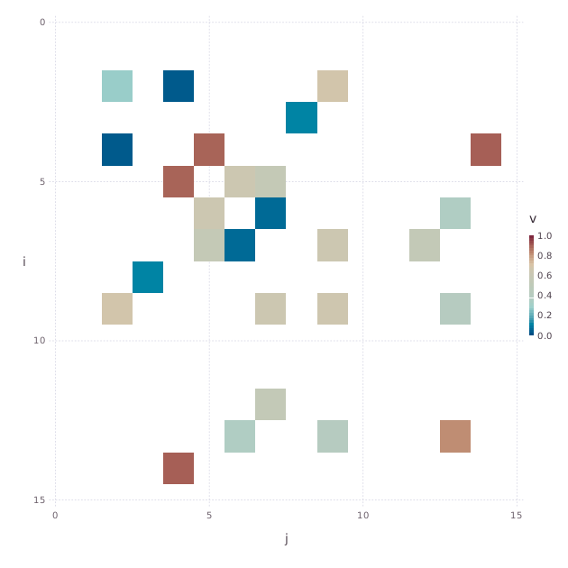

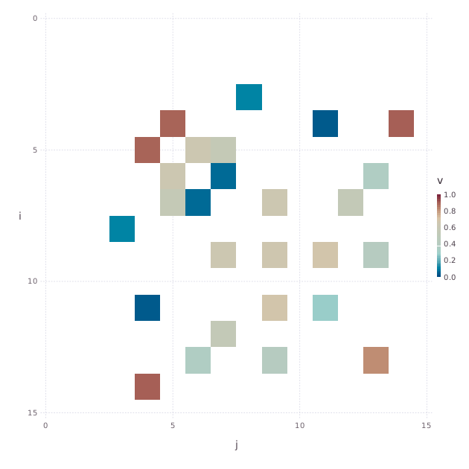

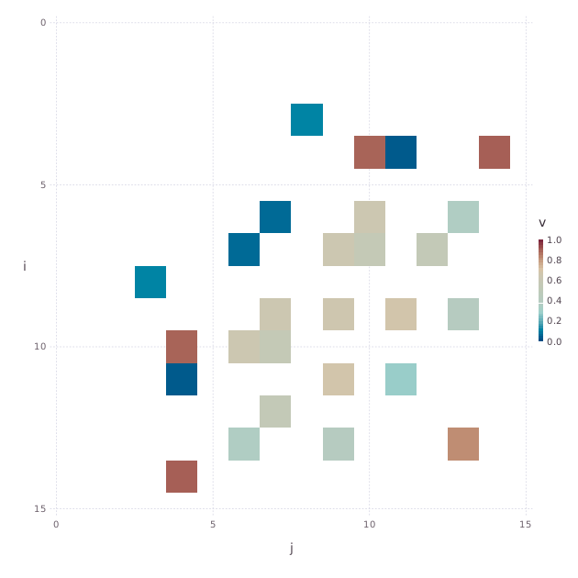

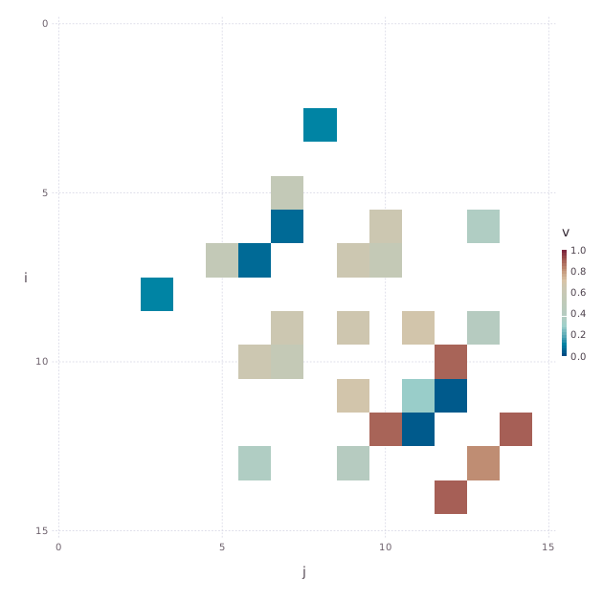
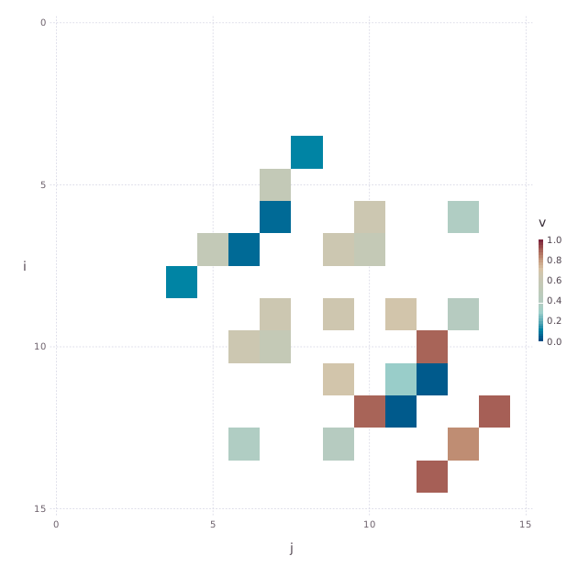
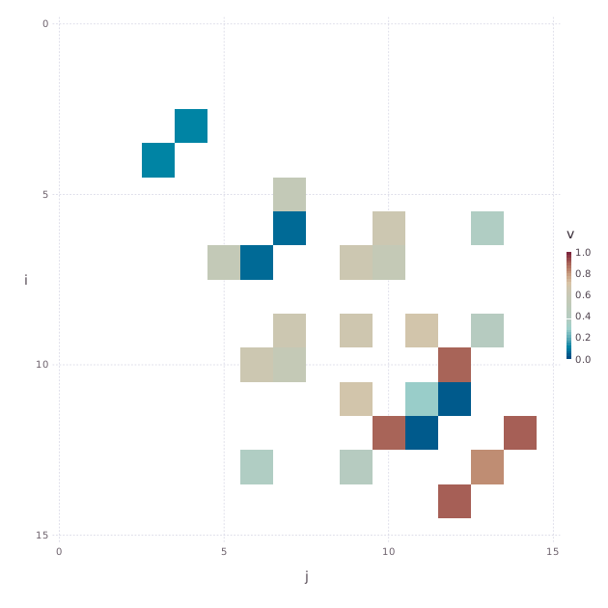
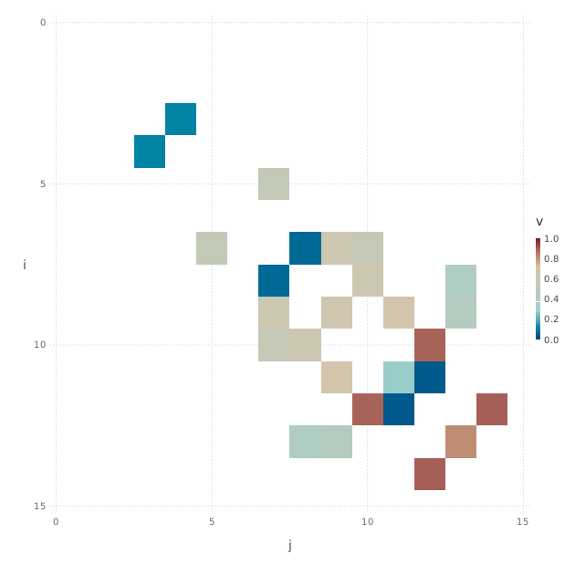
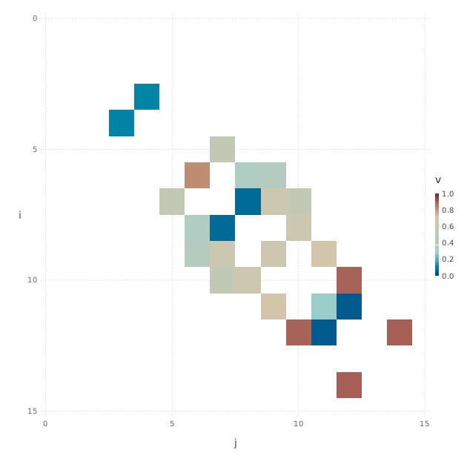
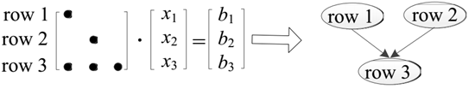
Context is key to optimizing sparse algorithms
Context: constant matrix properties and relations in a code region
A must be symmetric.
L must have the same structure as the lower part of A
L and A are loop constants
L = ichol(A)
…
while !converged
…
z = fwdTriSolve(L, r)
z = bwdTriSolve(L^{T}, z)
…
All function calls can share a task dep graph
Reordering helps perf

Slide 5
Context enables performance Example 1: PCG (Concept only)
TDG = inspect(A)
, TDG)
L = ichol(A)
…
while !converged
…
z = fwdTriSolve(L, r)
z = bwdTriSolve(L^{T}, z)
…
P,
, TDG)
, TDG)
, P)
x = P^{T}*x // inversely reorder
Reuse inspection. Collective reordering.
Optimize across library calls and matrices

Slide 6
PCG performance
GB/s
Machine peak
+Reordering
+Matrix properties
Baseline calling MKL
Only with context, high-performance library is efficient

Slide 7
Context enables performance Example 2: triangular solver
GB/s
Machine peak
+ reordering (Ninja)
+ reusing inspection results (MKL 13.1)
MKL 12.x

Slide 8
Context enables performance Other Examples
Application | Domain | Description
Interior point method | Operations research | Convex optimization
L-BFGS | Machine learning | Parameter estimation
CoSP2 | HPC | Electronic structure computation
Adiabatic | HPC | Quantum simulation
PageRank | Graph analytics | Rank web pages

Slide 9
But … applying context-driven optimizations has been manual, application-by-application, time-consuming even for experts!

Slide 10
Related work
Sparse matrix libraries
MKL, OSKI, Trilinos, Petsc, …
Easier programming frameworks
VFC, sparse polyhedral, …
Reordering
BFS, RCM, …
There are
Obstacles:
Library barriers ➔ single kernel/matrix focus
Low abstraction level ➔ difficult to analyze

Slide 11
Sparso
Automate context-driven optimizations for high productivity and performance, even for non-experts!
Reordering, inspector-executor
Optimize across library calls and matrices
Compiler-library collaborative approach
Compiler
Matrix property discovery
Collective Reordering
Optimized code
+
context
Context-aware wrapper
Library

Slide 12
A Julia implementation

Slide 13
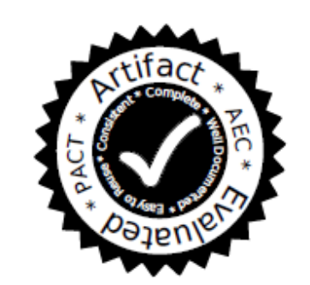
Simple to use!
Optimize iterative methods with sparse matrices
Open source:
https://github.com/IntelLabs/Sparso.git
using Sparso
@acc f(…)

Slide 14
Evaluation
Platform
14-core Xeon E5-2697 v3 HSW @ 2.6 GHz
Peak memory BW: 54 GB/s
Configurations
Julia-as-is
Baseline : replace each kernel with high-performance libraries (MKL and SpMP)
+Matrix-properties
+Reordering

Slide 15
Julia-as-is
Baseline
+Matrix properties
+Reordering
Machine peak
Machine peak
With context, 1.2X ~ 17X (average 5.7x) speedups vs. Baseline
PCG and PageRank >50% machine-peak

Slide 16
Conclusion
Sparse matrix is a key data structure in many areas
Exploiting context is a key to speed up sparse matrix applications
Sparso: automatic context-driven optimizations
General compiler/library analyses and optimizations
Break library boundaries by propagating context across library calls
Result: high-performance + productivity!

Slide 17
Call for collaboration
New challenges
KNL with heterogeneous memory
a configurable high-bandwidth memory in addition to the main memory
Generate FPGA accelerators from sparse algorithms
Cluster and distributed memory
Matrix-free optimizations
Communication avoidance
Python/R/Matlab
New applications
……
We are happy to support your research on top of Sparso!

Slide 18
Acknowledgement
The anonymous reviewers, Jed Brown, Karl Rupp, Brian Lewis, Lindsey Kuper, Michelle Strout, Xipeng Shen, Jiwon Seo, Tatiana Shpeisman, Christopher Hughes, Gilles Pokam, Rajkishore Barik, Pradeep Dubey, Paul Petersen, Youfeng Wu, Robert Hundt, Geoff Lowney

